Slide 1
Setting Up. Overview. Intro.
Groups 1 & 2
Shahi Abid, Jose Alvarez, Ernesto Brito, Komron Erkinov, Jianhong Li, Sabina Nizamova, Yarony Paulino, Natalia Russu, Liuyang Yang, Sammi Zeng, Alexis Marin, Sied Sakib

Slide 2
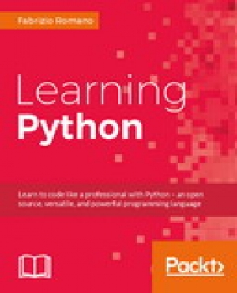

Overview of the project(Jose)
Purpose: create a promotional campaign for media agencies.
The book utilized will be ‘Learning Python’ by Fabrizio Romano.

Slide 3
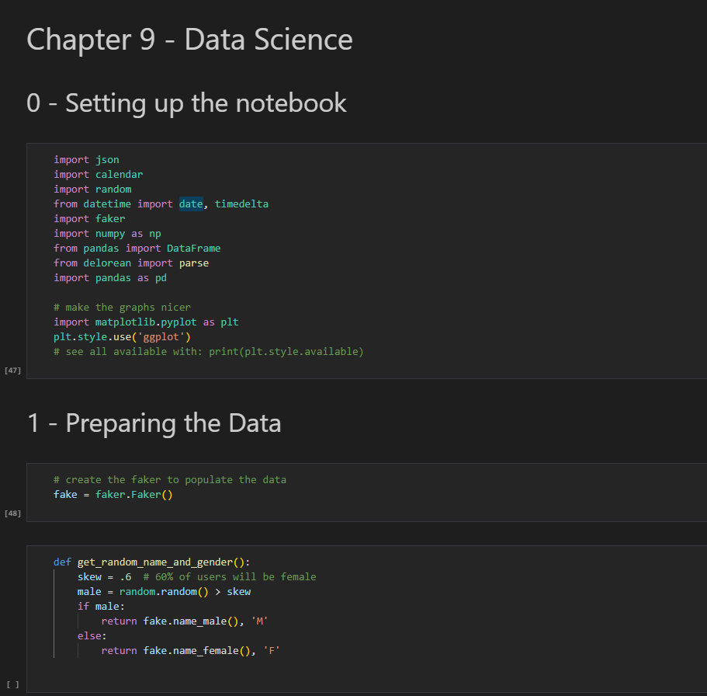
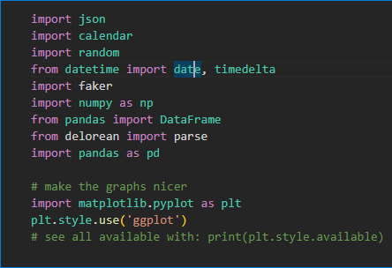
Overview of the project (Jose)
Part 0: Setting up the notebook.
Ipynb notebook based on chapter 9: Data Science
Notes:
“pandas is the very core upon which the whole project is based. “ O’reilly, ChP.9 ,,Dealing with Data”

Slide 4
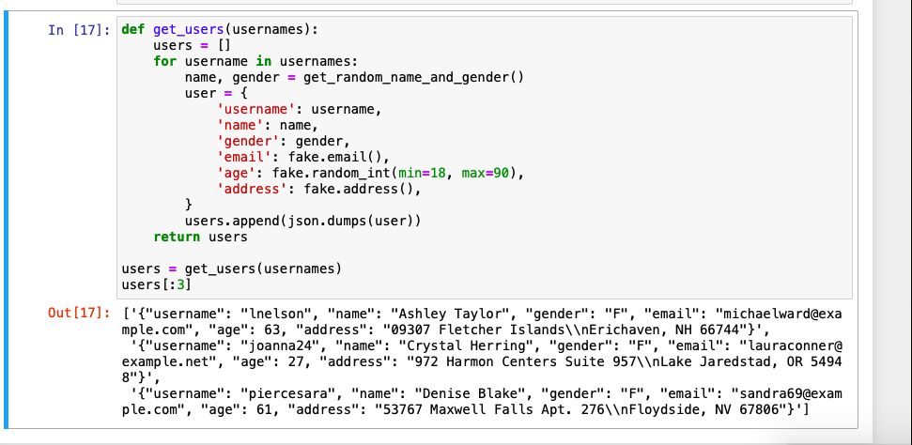
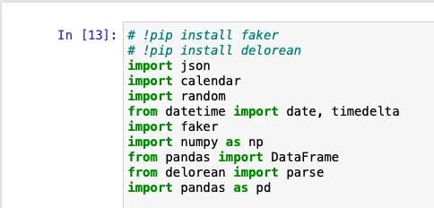
import JSON
Javascript Object Notation: standard text-based format for representing structured data
In Python, JSON exists as a string when storing JSON objects
json.dumps() function converts subset of Python objects into json strings
Creating a dictionary
Converting user (dictionary) into json strings and storing them in users (list)
Notes:
get_random_name_and_gender returns a tuple, or collection of Python objects. json function converts these objects into strings

Slide 5


Import random (Ernesto Brito)
- initiates the random module
-chooses randomly from “M”, “F”, or “B”
-chooses randomly from list of types

Slide 6
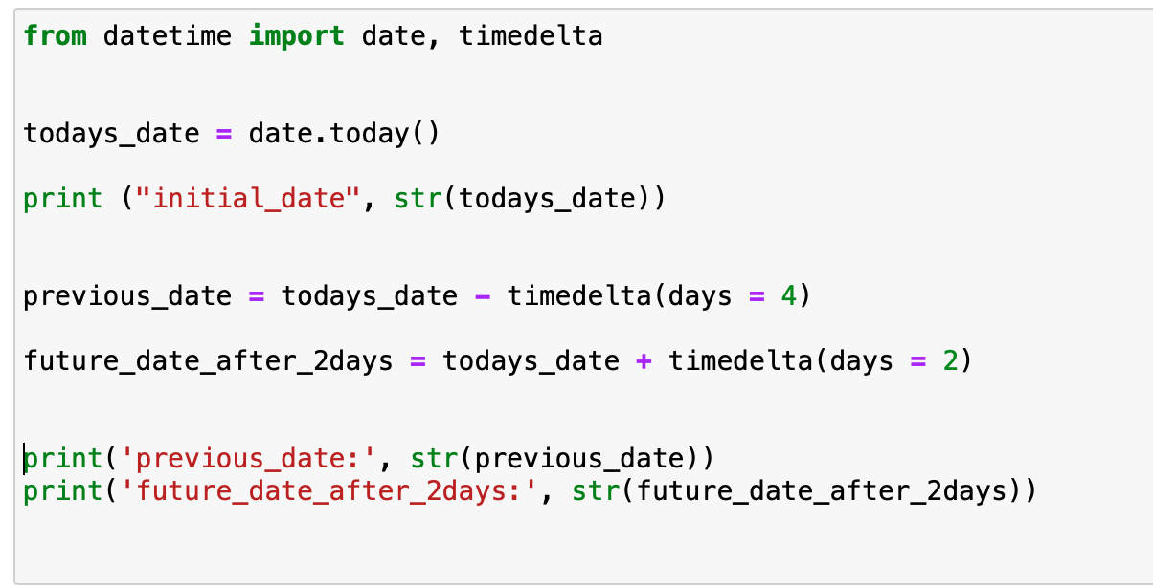
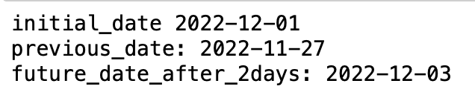
from datetime, import date, timedelta (Yarony)
Datetime library is used for date manipulations in python
The timedelta function is present through datetime library
Timedelta is used for calculating differences in dates
Output:

Slide 7
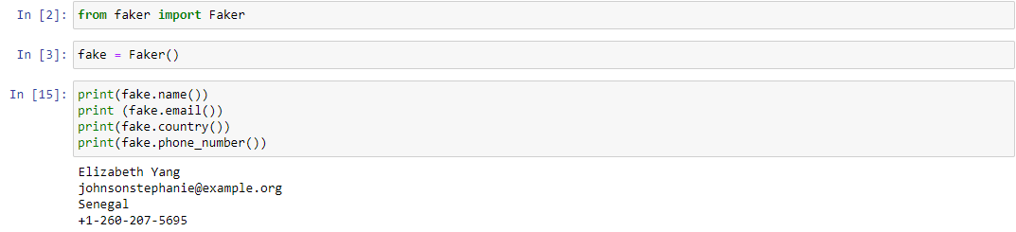
import faker (Shahi)
Python package that generates fake data for you
Used for testing or filling databases with some dummy data
faker.name(), faker.address(), faker.job(), faker.phone_number(), faker.words(), faker.profiles(), faker.numbers(), faker.md5(), faker.date_of_birth(), fake.country()
Notes:
Or: !pip install faker, if from jupyter notebook ( without !, if done from terminal). ONLY ONCE to be installed!

Slide 8
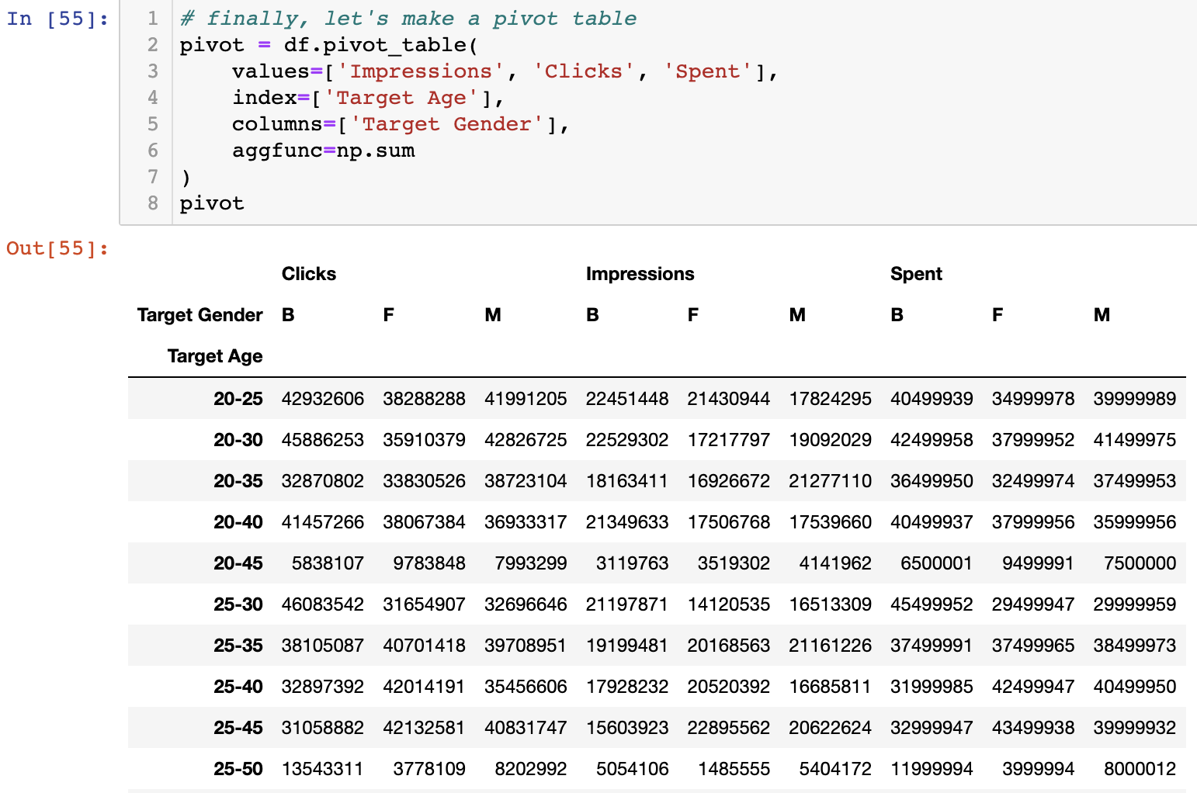
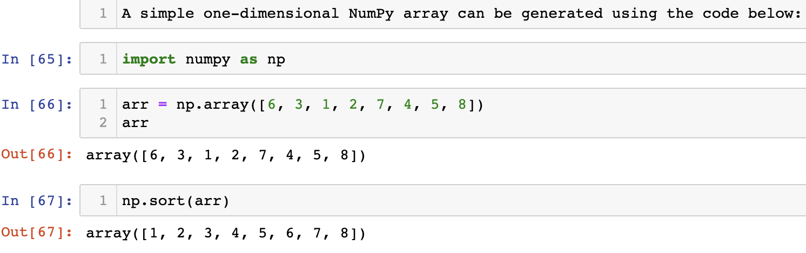
import numpy as np (Sabina)
Numpy, stands for Numerical Python, provides a multidimensional array object that may be used for a variety of mathematical operations.
Numpy is compatible with other libraries including pandas and matplotlib.
Many mathematical operations that are commonly used in scientific computing may be performed easily and quickly with Numpy.
NumPy's np.array() method can be used to build arrays, which is the most common data type to work with:
The np.sum function is used as the aggregation function to compute the results for pivot summary below:

Slide 9
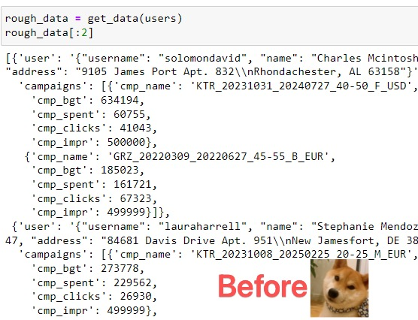
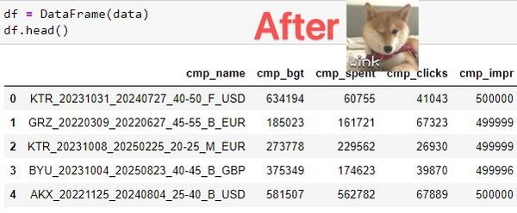




from pandas import DataFrame (Jianhong Li)
Pandas DataFrames are data structures that contain:
Data organized in two dimensions, rows and columns
Labels that correspond to the rows and columns
Creating a Pandas DataFrame：
Python dictionaries
Python lists
Two-dimensional NumPy arrays
Files （including CSV, Excel, SQL, JSON, and more）
pd.read_csv('data.csv‘）
Manipulating the DataFrames:
Accessing and Modifying Data
Inserting and Deleting Data
Applying Arithmetic Operations
Indexing, Slicing, Sorting, Filtering Data
Handling Missing Data
Inner/Outer, Left/Right Joins – merge(), concat()

Slide 10
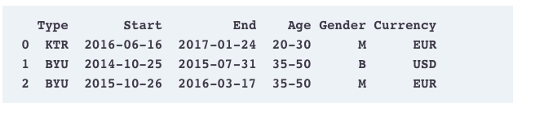
Delorean library ( Natalia Russu)
“delorean is a nice third-party library that speeds up dealing with dates dramatically.” - O’REILLY. Built on: pytz & dateutil.
To create a datetime object, with Delorean() (a) or to parse datetime strings (b):
!pip install delorean - to install it from notebook;
from delorean import Delorean
date_time = Delorean()
b)from delorean import parse
IS EASY, CONVENIENT for datetime conversions in Python(timezone shifting etc.) Technically, it is not mandatory, used to manipulate the DataFrame.
delorean.parse() - why use it?
To retrieve a proper date object out of the strings; output example (for project):
Notes:
https://github.com/myusuf3/delorean/blob/master/docs/quickstart.rst
https://delorean.readthedocs.io/en/latest/quickstart.html
https://stackabuse.com/comparing-datetime-with-delorean-in-python-with-and-without-timezones/
Delorean is a library that provides easy and convenient datetime conversions in Python. Dealing with generating lists of datetimes, timezone shifting, and much more.

Slide 11
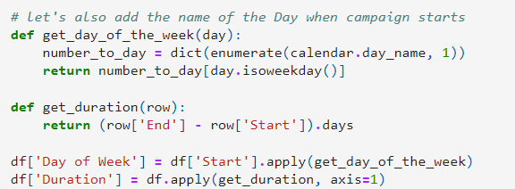
import calendar (alexis and sied)
Built in module which handles operations related to calendar
Able to display calendar of any given month or year
Allows calculation of various tasks based on any given date, month, and year
Able to format calendar to choose start of month, end of month, order in which dates are displayed, etc
Primary purpose is used for scheduling and planning
Notes:
How many weekdays in a given month or year, how many mondays or fridays are in a given month or year staff scheduling, workload management

Slide 12
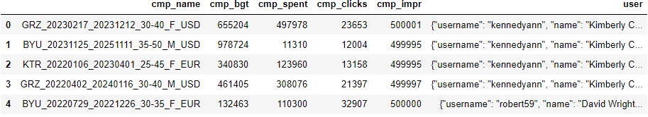
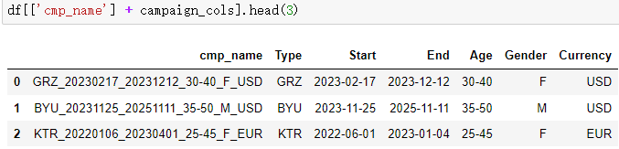
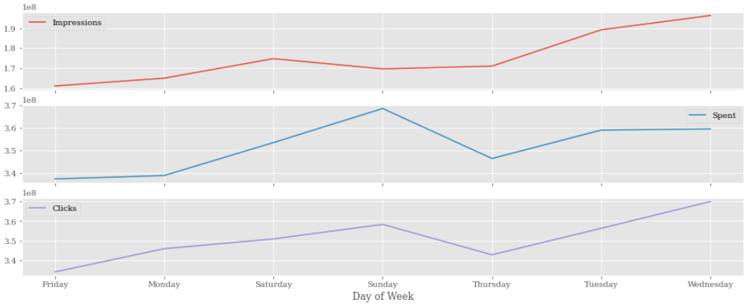
import pandas as pd (Liuyang)
What purpose does Pandas serve?
Data manipulation
The process of changing data to make it easier to read or process
Data Visualization
The process of finding trends and correlations in our data by representing it pictorially.
To perform data visualization in python, we can use various python data visualization modules such as Matplotlib

Slide 13
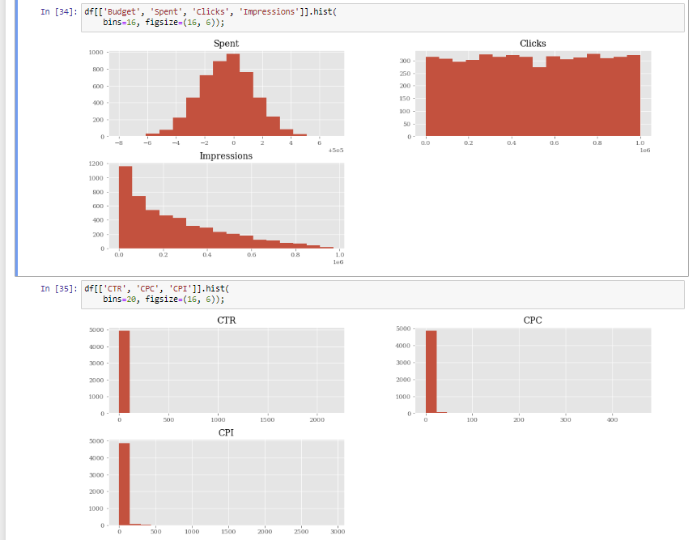
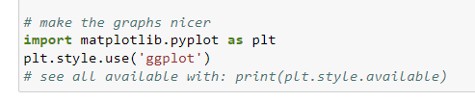
Import matplotlib.pyplot as plt (Komron)
Data Visualization
Matplotlib is a data visualization library made to replicate MATLAB
.pyplot is a function in the library which is used to plot 2d data
The style ‘ggplot’ is a plotting package in R, and this style package is used to emulate it
In this project its used to visualize impressions, clicks, and budget spent as a histogram.
Alternative visualization libraries:
Seaborn, Altair, Pygal
Notes:
Main libraries used in project: PANDAS, Matplotlib, Numpy

